Slide 1
An Efficient Intrusion Detection System using Advanced Machine Learning Techniques for Healthcare System
23B81A62E6-V KOUSHIK
23B81A62F5-R NILESH
23B81A62G4-KRISHNA PRASAD
Guide-Mrs. K Swathi (Assistant Professor)
Date- 27 February 2026

Slide 2
Abstract
Network intrusion attacks such as DDoS, infiltration, web attacks, and port scans pose serious threats to healthcare networks. These attacks can disrupt critical services and compromise sensitive patient data. Existing intrusion detection systems suffer from high false positives due to limited detection strategies or inability to detect zero-day attacks without prior signatures. To overcome these issues, this project proposes an efficient cascaded hybrid intrusion detection system using deep learning and ensemble machine learning techniques. A deep autoencoder is employed for unsupervised anomaly detection through reconstruction error analysis, trained exclusively on benign traffic to detect novel threats. An Isolation Forest provides complementary anomaly scoring through isolation-based statistical modeling. Both Stage 1 detectors are fused using weighted score combination with dynamic percentile thresholding to achieve high recall. Stage 2 applies a Random Forest classifier on suspicious samples to reduce false alarms and provide precise attack-type classification. The proposed cascaded architecture leverages both unsupervised zero-day detection and supervised refinement advantages. Experimental results demonstrate healthcare-grade performance with false positive rates below 5% and recall exceeding 90%, making the system suitable for production deployment in critical infrastructure environments.

Slide 3
Introduction
Network security breaches cost organizations billions annually Zero-day exploits and novel attack patterns evade signature-based detection
Need for adaptive, real-time anomaly detection systems that work on unseen attack types
Traditional rule-based IDS systems are reactive; this system is proactive Key
Problem Addressed:
High false positive rates in conventional IDS
Manual feature engineering and rule tuning overhead
Gap between training data and real-world network traffic

Slide 4
Literature Review
Authors & Year | Focus of the Paper | Key Contributions | Models Used | Dataset(s) Used | Performance Parameters | Research Gaps
S. Khan et al. (2025) | Optimizing IDS with Random Forest | Benchmarked a standalone high-accuracy supervised model on modern traffic. | Random Forest (RF) | CIC-IDS2017 | Accuracy: ~96% | No Zero-Day capability. As a purely supervised model, it cannot detect novel threats.
L. Zhou et al. (2021) | False Positive Reduction via ELM | Aimed to minimize false alarms in complex network environments. | Extreme Learning Machine (ELM) + HMM | CIC-IDS2017 | FPR: < 7%, Recall: ~84% | Low Recall. The focus on precision risks missing critical breaches.
T. P. Sharma (2021) | Cloud Data Security using ML | Optimized feature selection to reduce computational overhead | SVM + Genetic Algorithm (GA) | CIC-IDS2017 | Accuracy: ~91% | SVM is computationally expensive for real-time monitoring

Slide 5
A. A. Hady et al. (2020) (Base Paper) +1 | IDS for Healthcare using Medical & Network Data +1 | Combining network and patient biometric data improves detection by up to 25%. +1 | RF, KNN, SVM, and ANN. | EHMS Dataset (16k records). | AUC: ~93% (ANN), Accuracy: ~92%. +1 | Results show performance is "not optimal" and lacks specific zero-day detection logic.
M. Al-Zewairi et al. (2020) | Enhancing ML for 2018 Dataset | Evaluated standard algorithms to handle the massive scale of 2018 traffic. | KNN, RF, Logistic Regression | CSE-CIC-IDS2018 | Precision: ~92%, Recall: ~88% | High FPR; lacks a dedicated unsupervised pre-filter like your Deep Autoencoder.
A. Shone et al. (2018) | Deep Autoencoder for IDS | Focused on non-symmetric abstraction to reduce deep learning training time. | NDAEL (Non-symmetric Deep Autoencoder) | NSL-KDD, CIC-IDS2017 | Accuracy: ~85–89% | Low recall for minority attacks; lacks a Stage 2 classifier for attack-type identification.

Slide 6
Functional Requirements
Feature Extraction
Parse raw network packets (TCP/UDP flows)
Extract 12 selected bidirectional flow statistics:
Packet rates, byte counts, inter-arrival times
TCP flags (FIN, PSH), idle/active window statistics
Anomaly Scoring
Autoencoder reconstruction error detection
Isolation Forest anomaly scoring
Weighted fusion (0.7 AE + 0.3 IF)
Anomaly threshold: 0.5
Attack Classification
Random Forest binary classifier
Input: Stage 1 scores + flow features
Output: BENIGN or ATTACK labels
Real-time Monitoring
Live packet sniffing from network interface
Anomaly logging to JSONL with confidence scores

Slide 7
Non-Functional Requirements
Performance:
Latency: Sub-second inference per flow
Throughput: 500+ flow detections per second
Memory: ~200MB for trained models + 50MB runtime
Reliability:
Graceful error handling for network interface failures
Model checkpointing and persistence
Feature consistency across training/inference
Usability:
Command-line interfaces with sensible defaults
Comprehensive logging (console + file)
JSONL anomaly format for easy parsing/integration
Maintainability:
Modular code structure (src/ directory)
Unit tests for preprocessing, models, and inference
Configuration-driven parameters (config/default_config.yaml)
Security:
Runs with administrator privileges for packet capture only
No persistent storage of sensitive network data (logs are temporary)
Feature sanitization (no raw IP storage in training)

Slide 8
Hardware Requirements
Component | Requirement | Notes
CPU | Intel i5 / i7 or equivalent | Multi-core recommended for real-time processing
RAM | 8 GB minimum | 16 GB recommended for smoother training & testing
Storage | ~2 GB total | Models: ~400 MB, Datasets: ~1 GB, Logs: variable
Network Interface | Live NIC or Virtual Adapter | Required for packet capture

Slide 9
Software Requirements
Component | Tool / Library | Version | Purpose
Deep Learning | TensorFlow / Keras | 2.13+ | Autoencoder architecture
ML & Anomaly Detection | scikit-learn | 1.3+ | Isolation Forest, Random Forest, preprocessing
Data Processing | pandas, NumPy | Latest | Flow feature computation
Packet Capture | Scapy | 2.7.0 | Raw packet sniffing & parsing
Config Management | PyYAML | 6.0+ | YAML-based configuration
Component | Recommended Configuration | Purpose
Operating System | Windows 10 / 11 | Stable development environment
Packet Capture Driver | Npcap Installed | Required for Scapy packet sniffing
Programming Language | Python 3.10+ | Core Programming Language
Network Speed | 1 Gbps Interface | Supports high flow throughput

Slide 10
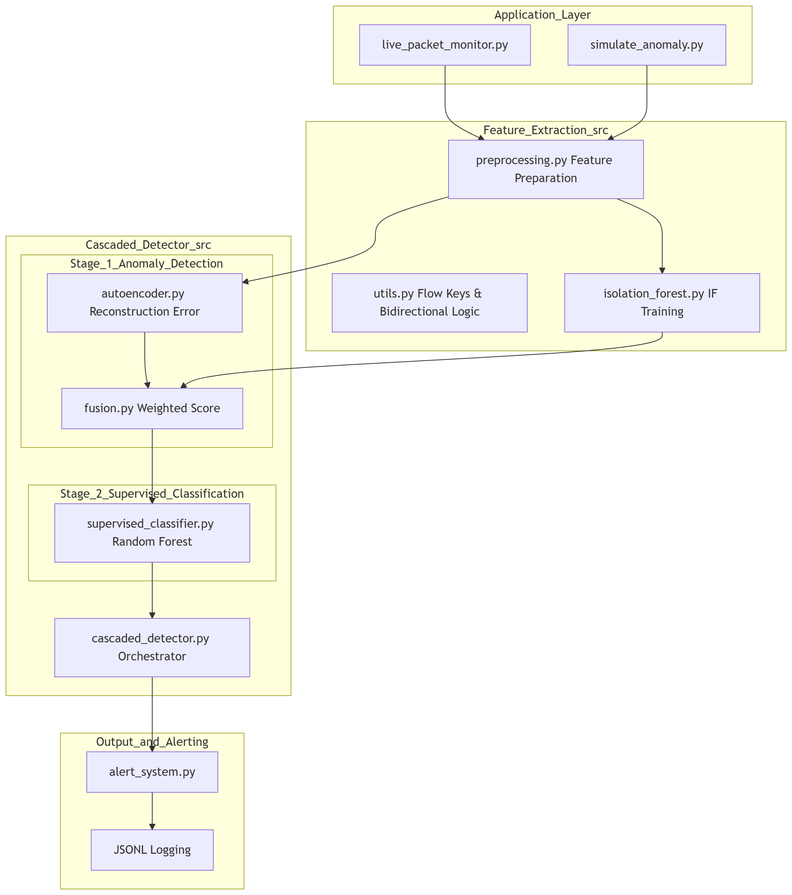
Modular Architecture

Slide 11
Existing work/method and challenges
Existing System | Core Idea | Strengths | Limitations | Why We Needed Our System
Signature-Based IDS (Snort, Suricata) | Match traffic against known attack signatures/rules | Accurate for known threats, low false alarms, fast matching | Cannot detect zero-day/unknown attacks, requires constant rule updates | Need detection beyond known signatures
Rule / Threshold-Based Monitoring | Trigger alerts when traffic exceeds fixed thresholds (rate, ports, bytes) | Simple, lightweight, easy to deploy | High false positives in dynamic environments, difficult to tune globally | Need adaptive, context-aware detection
Statistical Anomaly IDS | Build baseline of normal traffic and flag deviations | Can detect previously unseen behavior | Baseline drift, unstable over time, noisy alerts | Need stable and controlled anomaly filtering
Single-Model ML IDS (SVM/RF/NN only) | One ML model directly classifies benign vs attack | Learns patterns better than static rules | Risk of overfitting, weak generalization to unseen attacks | Need multi-stage detection for robustness
Flow Analysis Platforms (Zeek/Bro + scripts) | Deep protocol and flow visibility using scripting | Excellent traffic visibility, strong for forensics | Detection quality depends on custom logic, complex setup | Need integrated ML-based decision pipeline

Slide 12
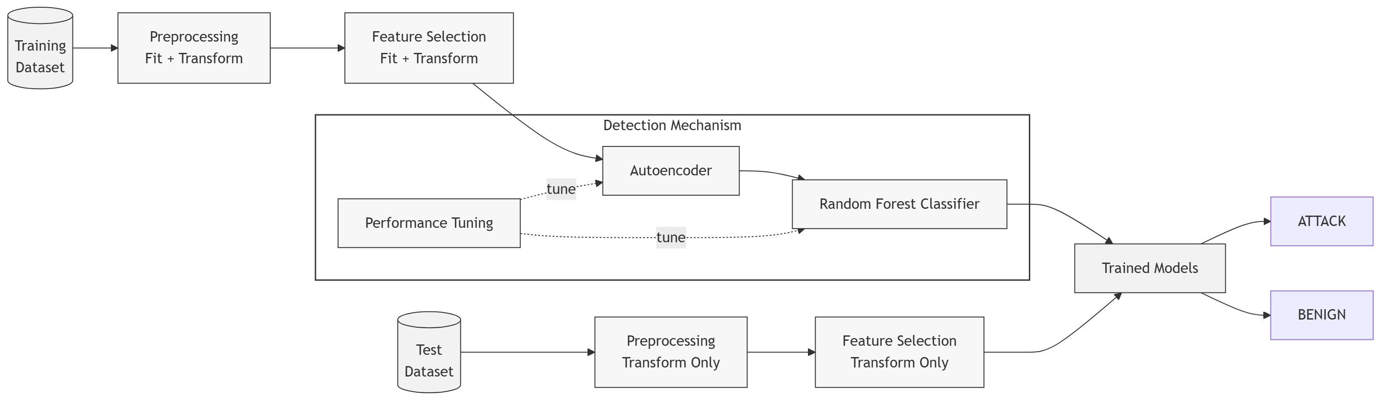
System Architecture

Slide 13
Thank you

